Slide 1
CES 361
Fundamentals of Software Testing
Session 7

Slide 2


Review of Black Box Techniques Discussed So Far
Step 1: Use the requirements to divide the input into “Equivalence Partitions”
Step 2: Develop test cases on and around the “boundaries”
Step 3: In cases of multiple requirements and variables, use “pairwise testing” to maximize coverage while keeping the number of test cases manageable
Step 4: Create “decision tables” to further analyze which cases should be tested more heavily and which can be tested more lightly or skipped
What haven’t we paid much attention to?
Valid Input
in other words, is this enough?
Valid
Input
Invalid Input
Valid Input
Invalid
Input
Invalid Input

Slide 3
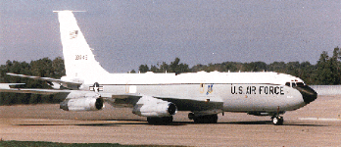



A shift in the testing goals, from strategic coverage to performance
We will classify three...
Performance Testing
Load Testing
Stress Testing
What can you tell me about these three?
Asks the question:
“Are there any bottle-
necks? (not bugs)”
Asks the question:
“Can this program
handle the max load?”
Asks the question:
“What happens when we
exceed the max load?”
Things we check for:
Things we check for:
Things we check for:
scalability
concurrency
performance
high-load runs
  full databases
  long runs over time
  high I/O traffic
memory leaks
buffer overflows
graceful degradation
system response
security vulnerabilities
Good examples:
Good examples:
Good examples:

Slide 4


Important Questions
What are the implications for system requirements?
These two
bullets
may seem
innocuous,
but the
implications
are nothing
less than
profound
Hint: What is Grand Truth #1 for this course?
What challenges does this present to the tester?
Hint: What is Grand Truth #2 for this course?
Your questions?
Notes:
#1) You can’t test without defined requirements. #2) Allow sufficient time for testing.

Slide 5
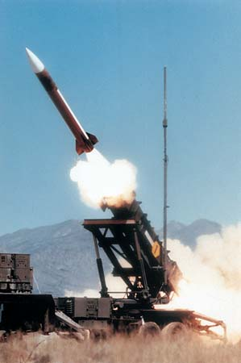
Glitch of the Day
What is this?
What happened?
The small chopping error, when multiplied by the large
number giving the time in tenths of a second, led to a
significant error. Indeed, the Patriot battery had been
up around 100 hours, and an easy calculation shows
that the resulting time error due to the magnified chop-
ping error was about 0.34 seconds.
A Scud travels at about 1,676 meters per second, and
so travels more than half a kilometer in this time.
As a tester, what does this tell you?

Slide 6

October will be a blast!
(New Assignment on Pilot: )
HW3 HW4 HW5 Proj2
Essentially, this is Project 2, divided into 4 parts
The first three parts are graded HW assignments
HW is due on Wednesdays
I will hand them back on Monday
You can make improvements as we go,
so your project can be “better” than
your homework assignments
Why do
I do this?
1.
2.
Avoid procrastination
Opportunity for feedback

Slide 7
This slide intentionally left blank

